Slide 1
Things you can do if you bite off more than you can chew
A discussion of opportunities, role changes, and work/life balance

Slide 2
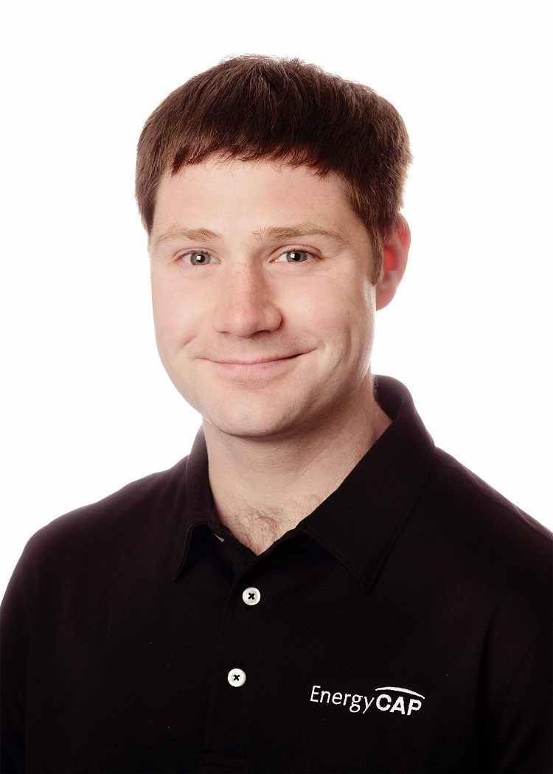

About Me
Father of two three, fighting robot builder, and director of the Technology Enablement Team at EnergyCAP. I enjoy all things engineering, especially inspiring young people to pursue it.
https://www.energycap.com/careers
Zac ODonnell
Director of Technology Enablement
EnergyCAP LLC
zac.odonnell@energycap.com
Let’s Connect!

Slide 3
Goals of the Talk
This talk WILL…
Tell a story that many have faced
Describe some approaches that worked, and some that did not
Be a discussion rather than a lecture
This talk WILL NOT…
Solve all of your problems
Match your experiences exactly
Include an AI demo

Slide 4

Story Time
Notes:
With three kids you end up doing a lot of story time. Today I’m going to start with a story. It might be like one you’ve heard before. See if there are any familiar parallels…

Slide 5
Your boss comes to you with an “opportunity”. The business has a serious need. There’s a team that is struggling and facing a serious new challenge.
It’s not really in your technical wheelhouse, but it’s a chance to make a real difference… Will you take the leap?

Slide 6

What you thought you signed up for
A big, meaty project with some challenges in play
Something you can wrap your arms around and finally give it the attention it deserves
Image credit: Pedro Furtado

Slide 7
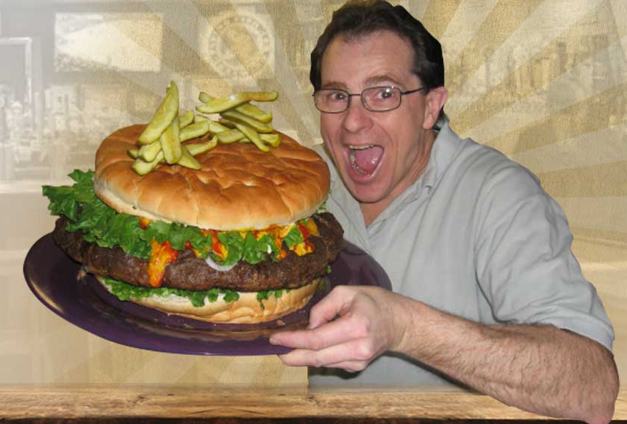
What you actually got
A surprising number of scalability challenges
Limited documentation and testing
A lack of clarity around where things actually stand
A bellyache waiting to happen
Image Credit: Denny’s Beer Barrel Pub, Clearfield PA

Slide 8
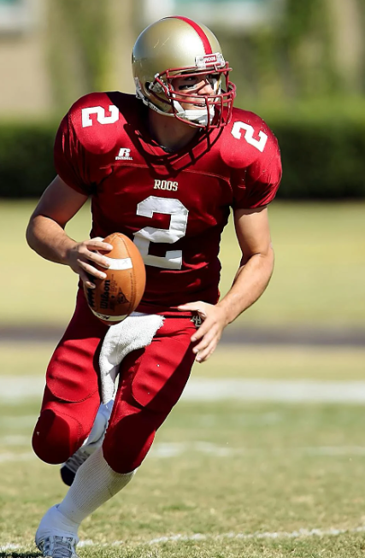
How you saw the role
Leading a newly-formed team to victory over a long-standing challenge
Taking some early hits as things get off the ground
A steady march into new territory for the team and the company
Image credit: Pixaby

Slide 9
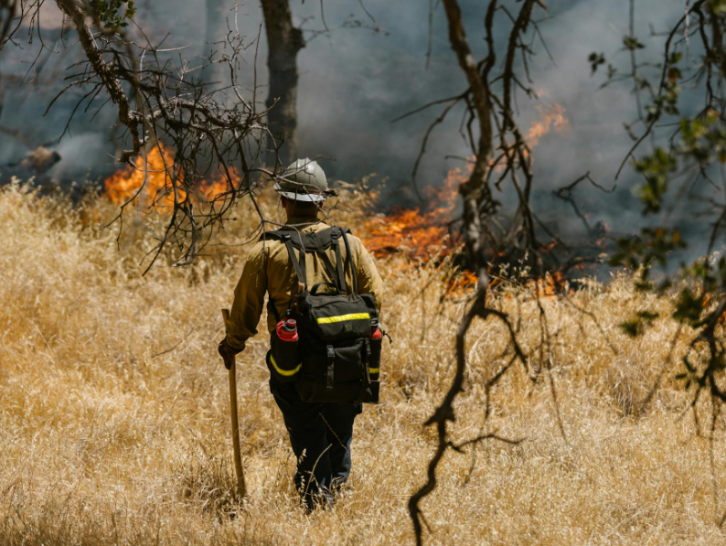
How the role felt initially
Emergent work coming in faster than you can triage
Lurching from one unplanned fire to another
75% of your time spent in meetings is “the new normal”
Operational issues distracting from any kind of coherent plan
Image Credit: RDNE Stock Project

Slide 10

Signs you are falling behind
Outlook won’t even show you the number of unread messages
Most of the team’s work is reactive and unplanned
You find new high-priority work faster than you can finish it
Image Credit: RDNE Stock Project

Slide 11
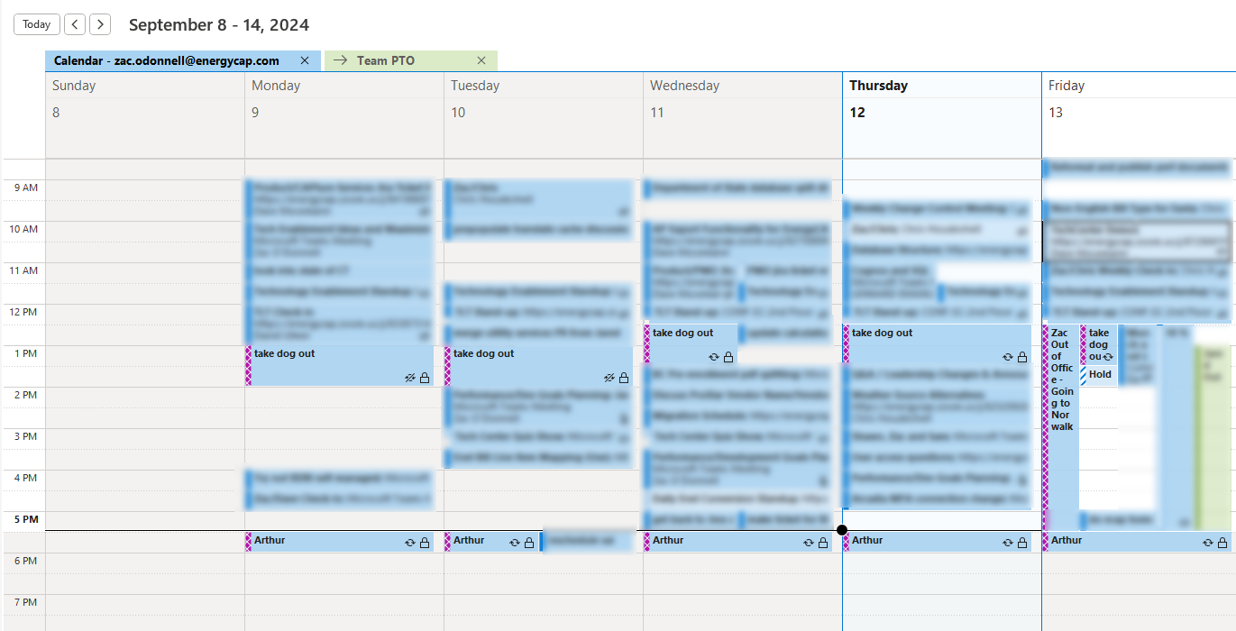
“It’s not a good sign when you have to put your dog and your kid on your calendar so they don’t get overlooked”

Slide 12

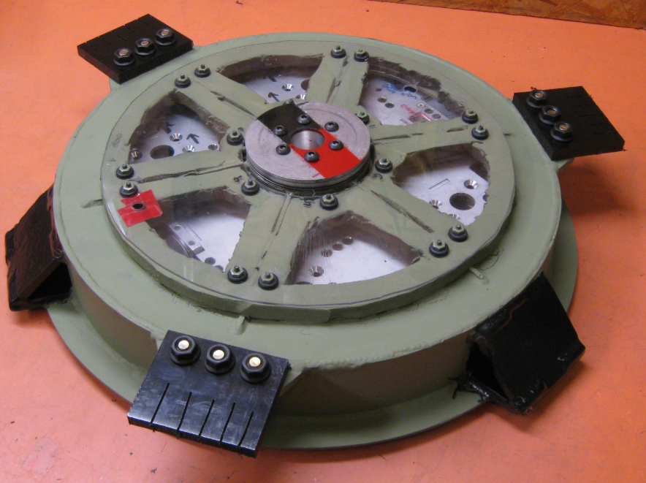


Work/Life Timelines
7/29
Role
Accepted
10/6 First “caught up”
Late Oct 3 weeks Paternity Leave
7/25
Role
Offered
8/12
First Day
Many work challenges
8/22 Family Wedding Denver
9/13-15 Robot Competition
9/25-27 3 Techbash Presentations
Late Oct Baby #3
8/27 Funeral San Diego

Slide 13

Some perspective
Image Credit: Pixabay
Notes:
Raise your hand if you have children. Ok, raise your hand if you would consider the first three weeks with a newborn a vacation. That is what it felt like. I was fortunate enough to be able to take 3 weeks of paternity leave and it really was a break I needed.

Slide 14
Some perspective
“Picture that you’re drowning… and then somebody hands you… a baby” – Jim Gaffigan
Image Credit: Pixabay

Slide 15
Where can you go?
Ok, you’re in over your head. How do you get back on track?

Slide 16
Team policies that can help
Prioritize a few very impactful or distracting issues to buy capacity to go after the bigger, harder ones
Defer things that have existing workarounds or are low frequency
Stop the bleeding, record the context, triage next steps based on remaining known issues

Slide 17
Team policies that can help - psychological
Team “Roundtable” meetings to build up some cross-training and connection
Create a list (jira filter, shared doc, poster, etc) that records real, positive impacts you and the team are having even amidst the madness. Celebrate new things going on it.
Improve personal meeting time to execution time ratio by blocking focus time

Slide 18
Overall Strategy
Eliminate
Automate
Delegate

Slide 19

Eliminate
Remove busywork and things that don’t actually help
Look for information silos and break them down to avoid bottlenecks

Slide 20
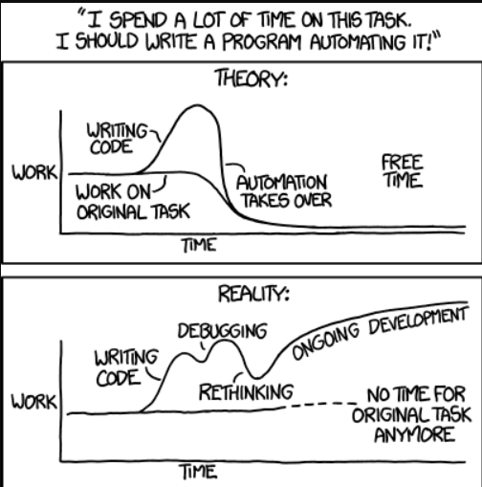
Automate
Automate monitoring tools to spot issues before they are multi-day recovery problems
Automate recovery and reporting processes (jira automation, simple powershell scripts, etc)
Image Credit: XKCD

Slide 21

Delegate
Try to find a new home for distracting or orthogonal work
Remove bottlenecks to empower others via documentation and training
Image Credit: Mohammad Danish

Slide 22
Still not working?
Communicate

Slide 23

Communicate
Tell the higher ups that it isn’t working before the crash comes
Frame it as “we want to do these things but are being held back by those roadblocks”
Image Credit: Andrea Piacquadio

Slide 24
Still still not working?
Find some perspective

Slide 25

Find Perspective
Avoid imposter syndrome
Who else would do it better?
They don’t hire in new leaders if it was thriving
Keep an eye on your support systems
There is no done
Image Credit: Miguel Á. Padriñán

Slide 26
Things to Avoid
Avoid having an “Everything Else” team
The scope of everything else grows forever
Giving in to the temptation to only assign work to the single most effective person every time “because it is urgent”
Ignoring the signs of burnout in yourself and your team members “just a little longer”

Slide 27
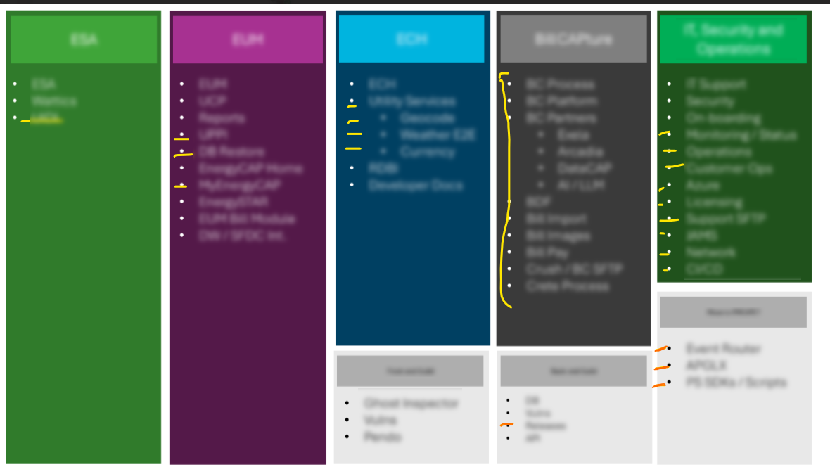
A storybook ending
Communicate

Slide 28
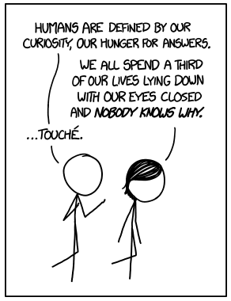
Questions?
Zac ODonnell
Director of Technology Enablement
zac.odonnell@energycap.com
Credit: XKCD - https://xkcd.com/1345

Slide 29
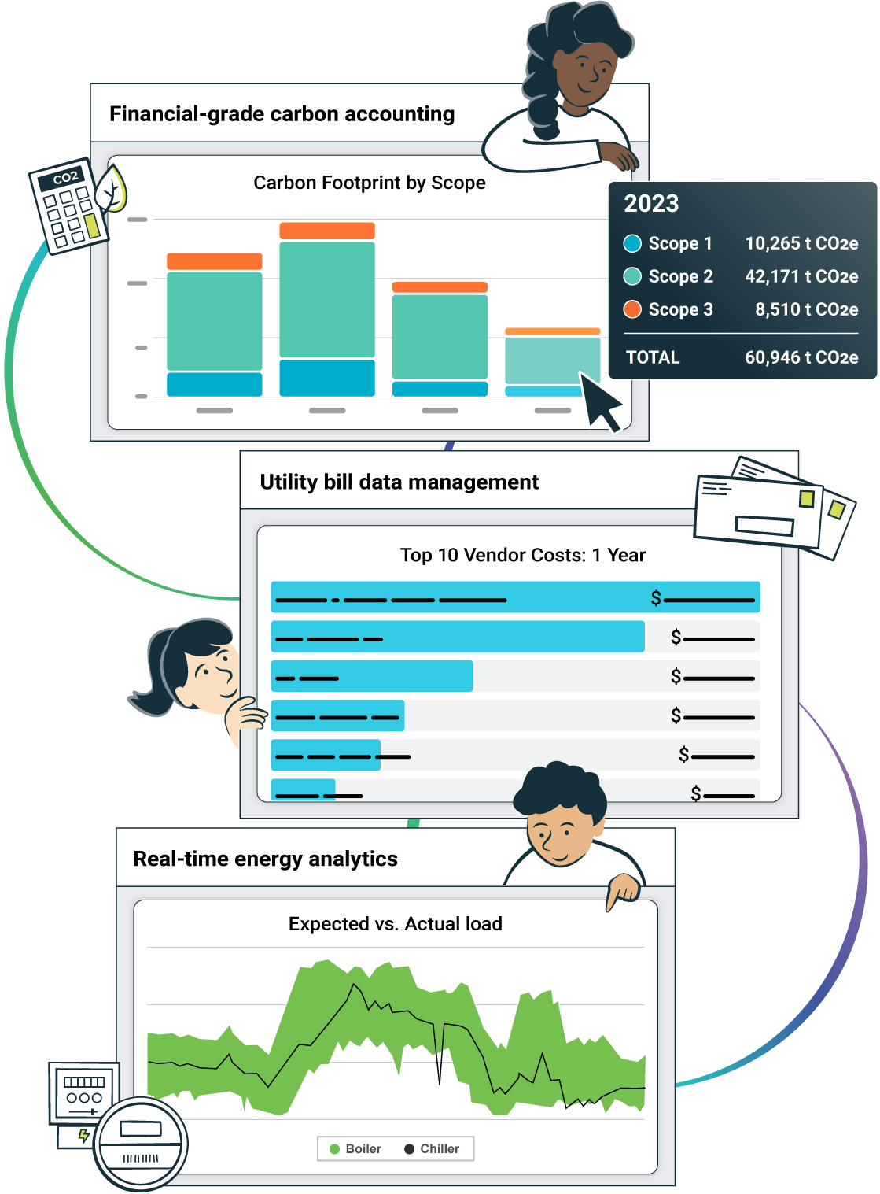
The single source of truth for energy and sustainability teams
Our energy and sustainability software gives you instant access to actionable data you can trust to better manage resource consumption, reduce your carbon footprint, and drive massive savings.

Slide 30
